Slide 1

How to Make an Accessible Document in Microsoft Word
An Introduction to Accessible Documents

Slide 2
How to Make an Accessible Document in Microsoft Word
Module 1: Save as a Word Document ‘.docx’ with a Descriptive Filename.

Slide 3

Accessible Word documents must be saved in the .docx format with a descriptive file name that identifies your document or its purpose.
Descriptive file names help everyone, including people with disabilities, locate, open, and switch between documents.

Slide 5
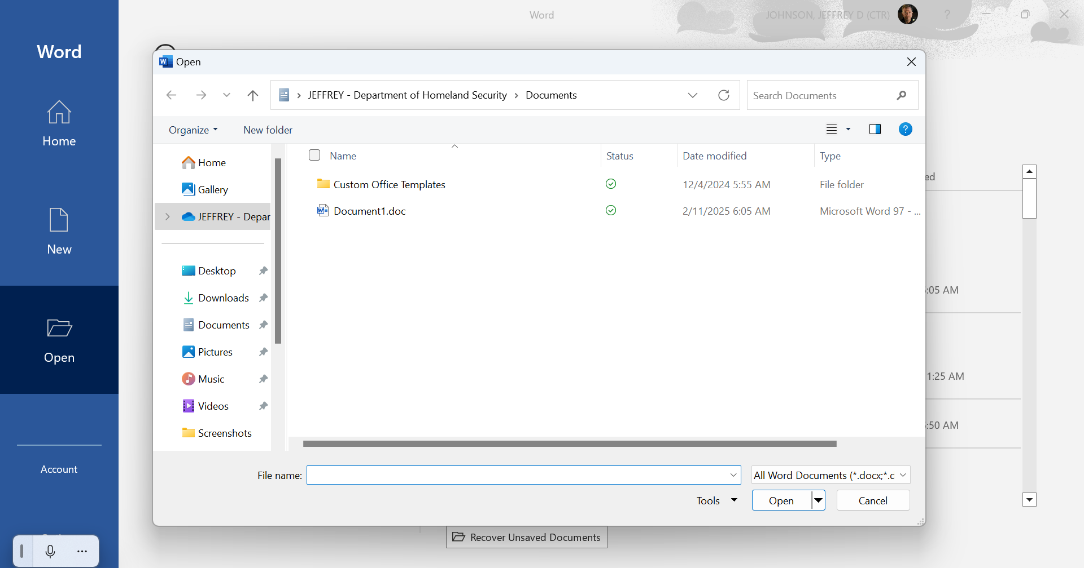

Slide 6
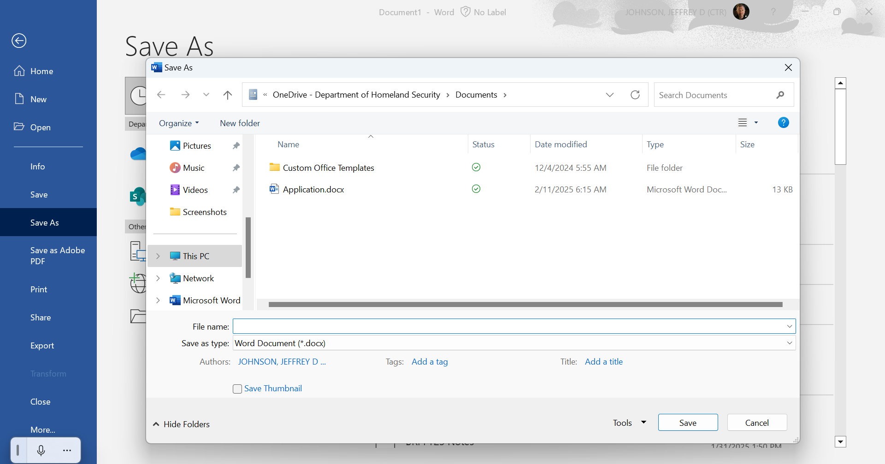

Slide 7
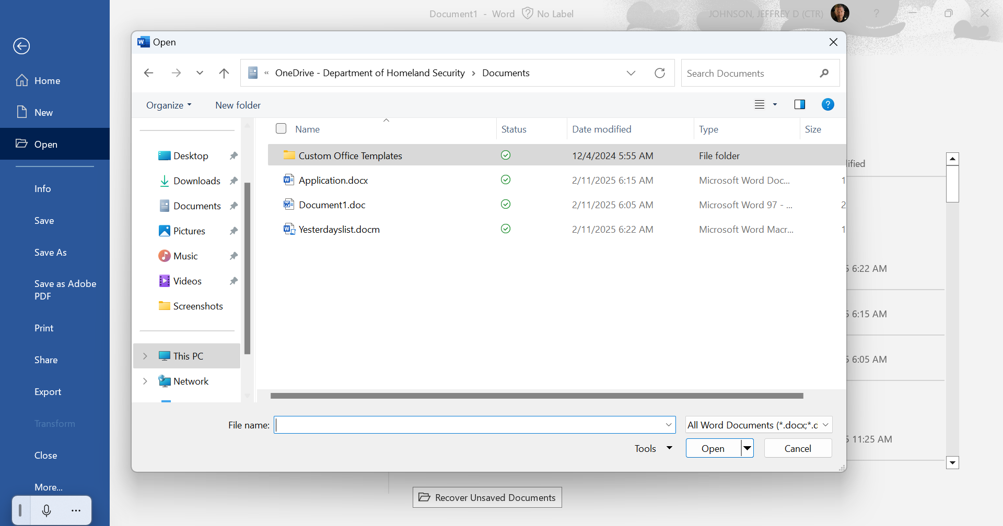

Slide 8
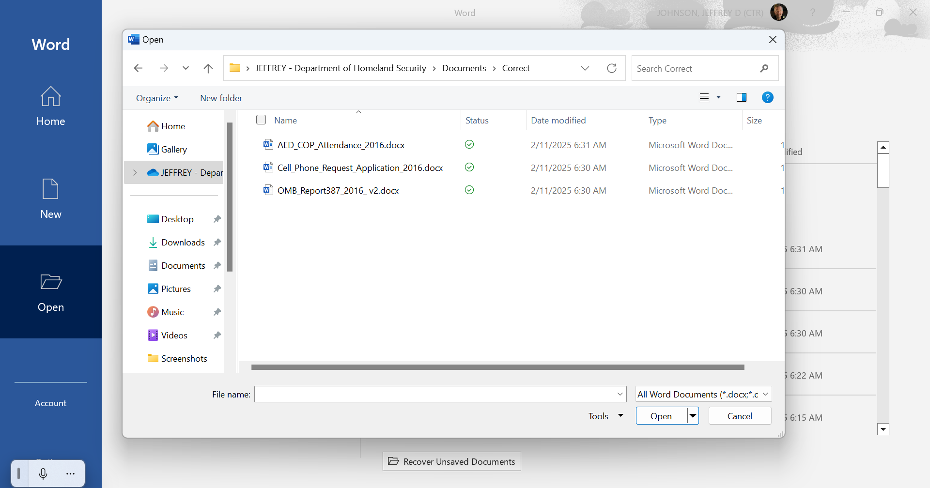

Slide 9
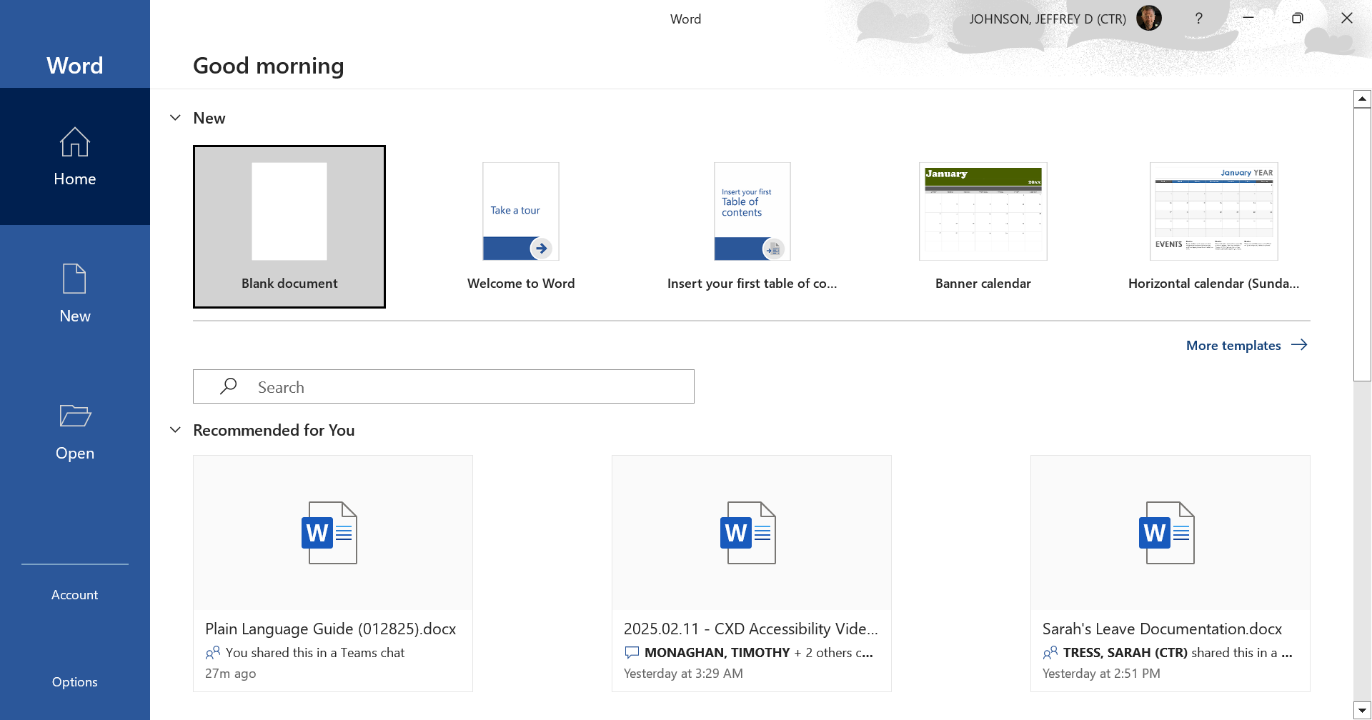

Slide 10
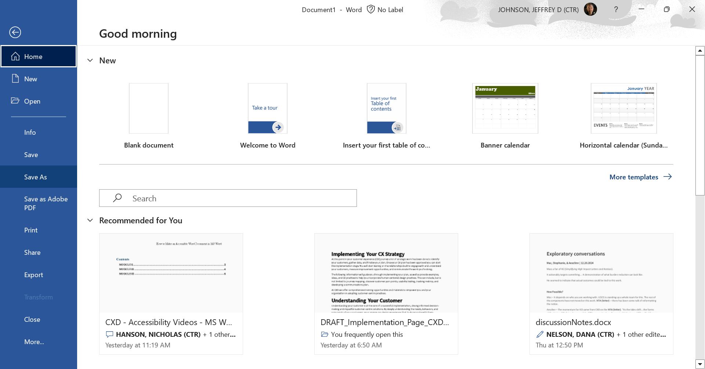

Slide 11
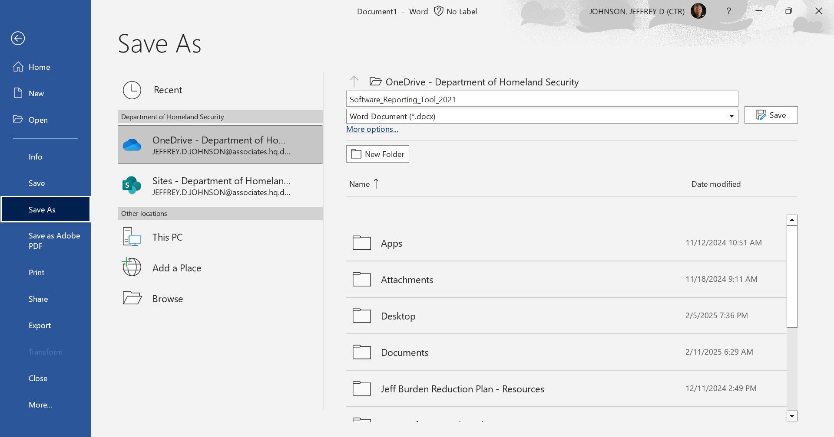

Slide 12
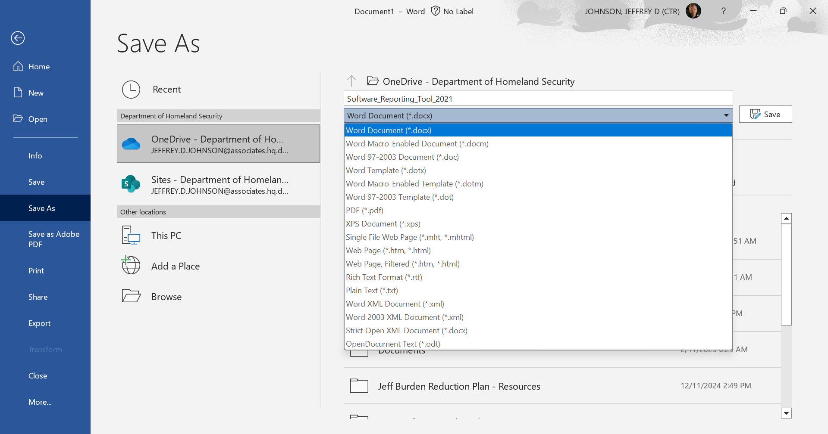

Slide 13
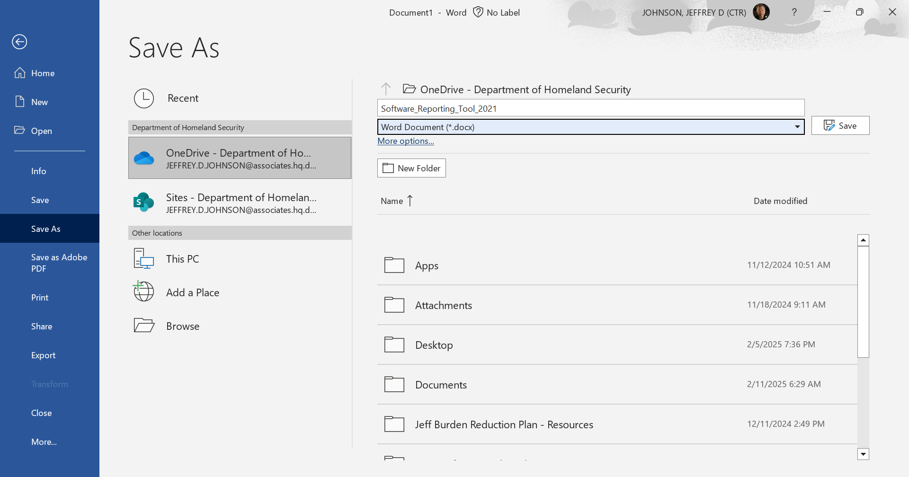

Slide 14
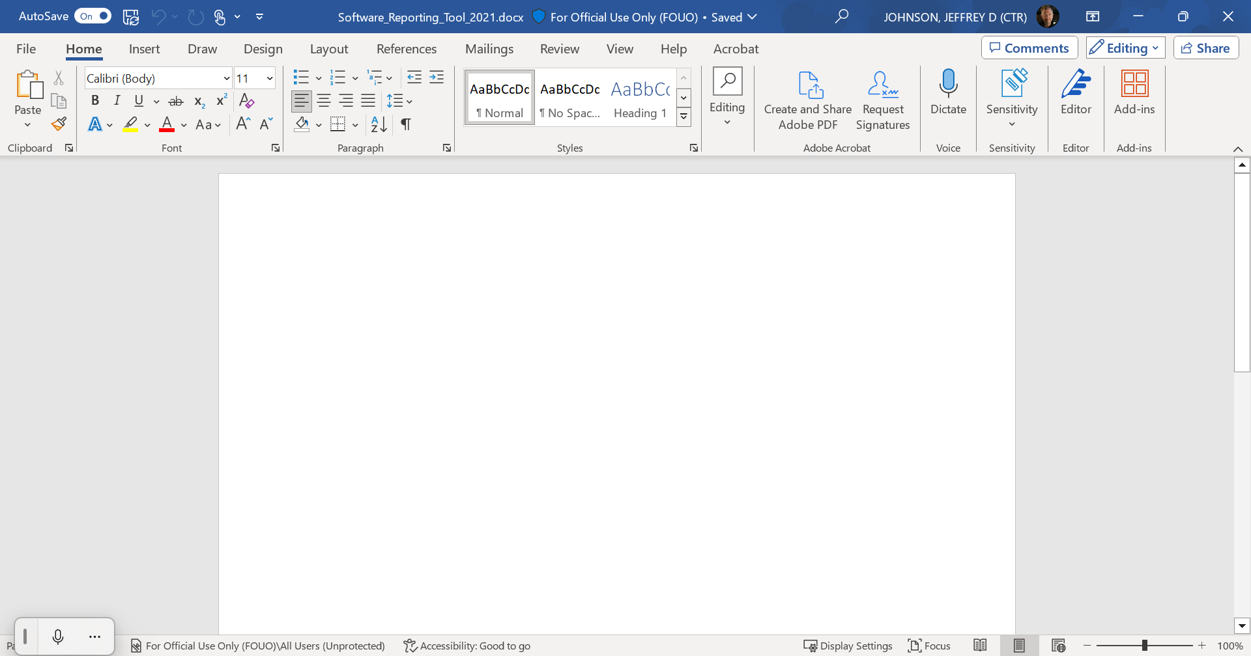

Slide 15
Thank you for watching Module 2. Please watch the entire video series to learn all the steps for authoring and testing accessible documents. For more information about creating accessible documents and other accessibility topics, visit Section508.gov.

Slide 16
This video is a product of the Accessible Electronic Document Community of Practice and the U.S. Department of Homeland Security.

Slide 17
How to Make an Accessible Document in Microsoft Word
Module 2: Use Styles to Create Headings

Slide 18
Headings are names or labels that break up content and make finding information easier. Assistive technology, like screen readers, cannot infer meaning from simple formatting, such as bolded or underlined text.

Slide 19
You can use Microsoft Word's built-in ‘Styles’ to create a clear heading structure in your document that assistive technology can access to help individuals with disabilities navigate your document’s content.

Slide 20
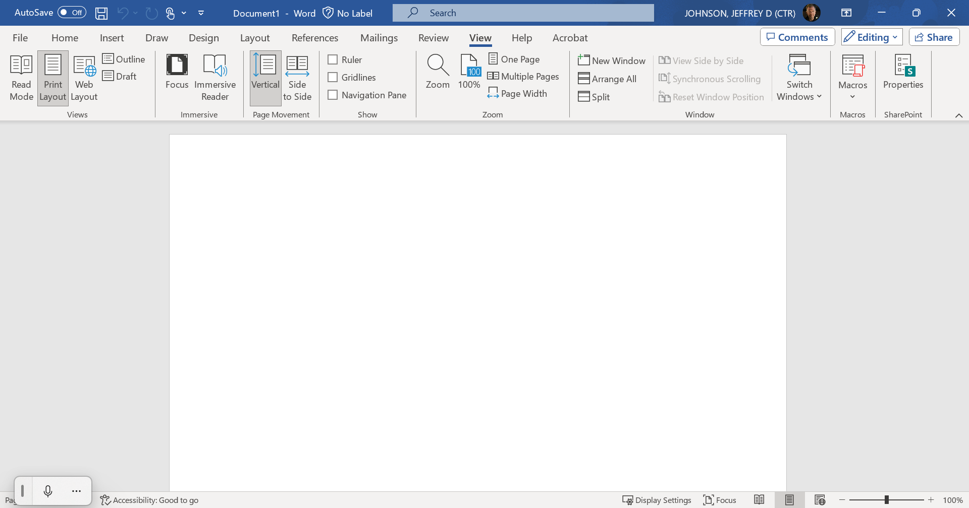

Slide 21
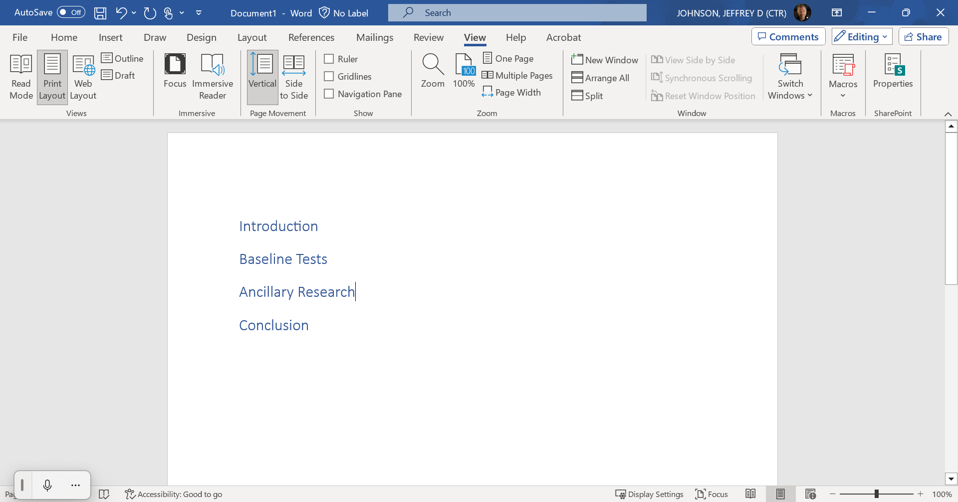

Slide 22
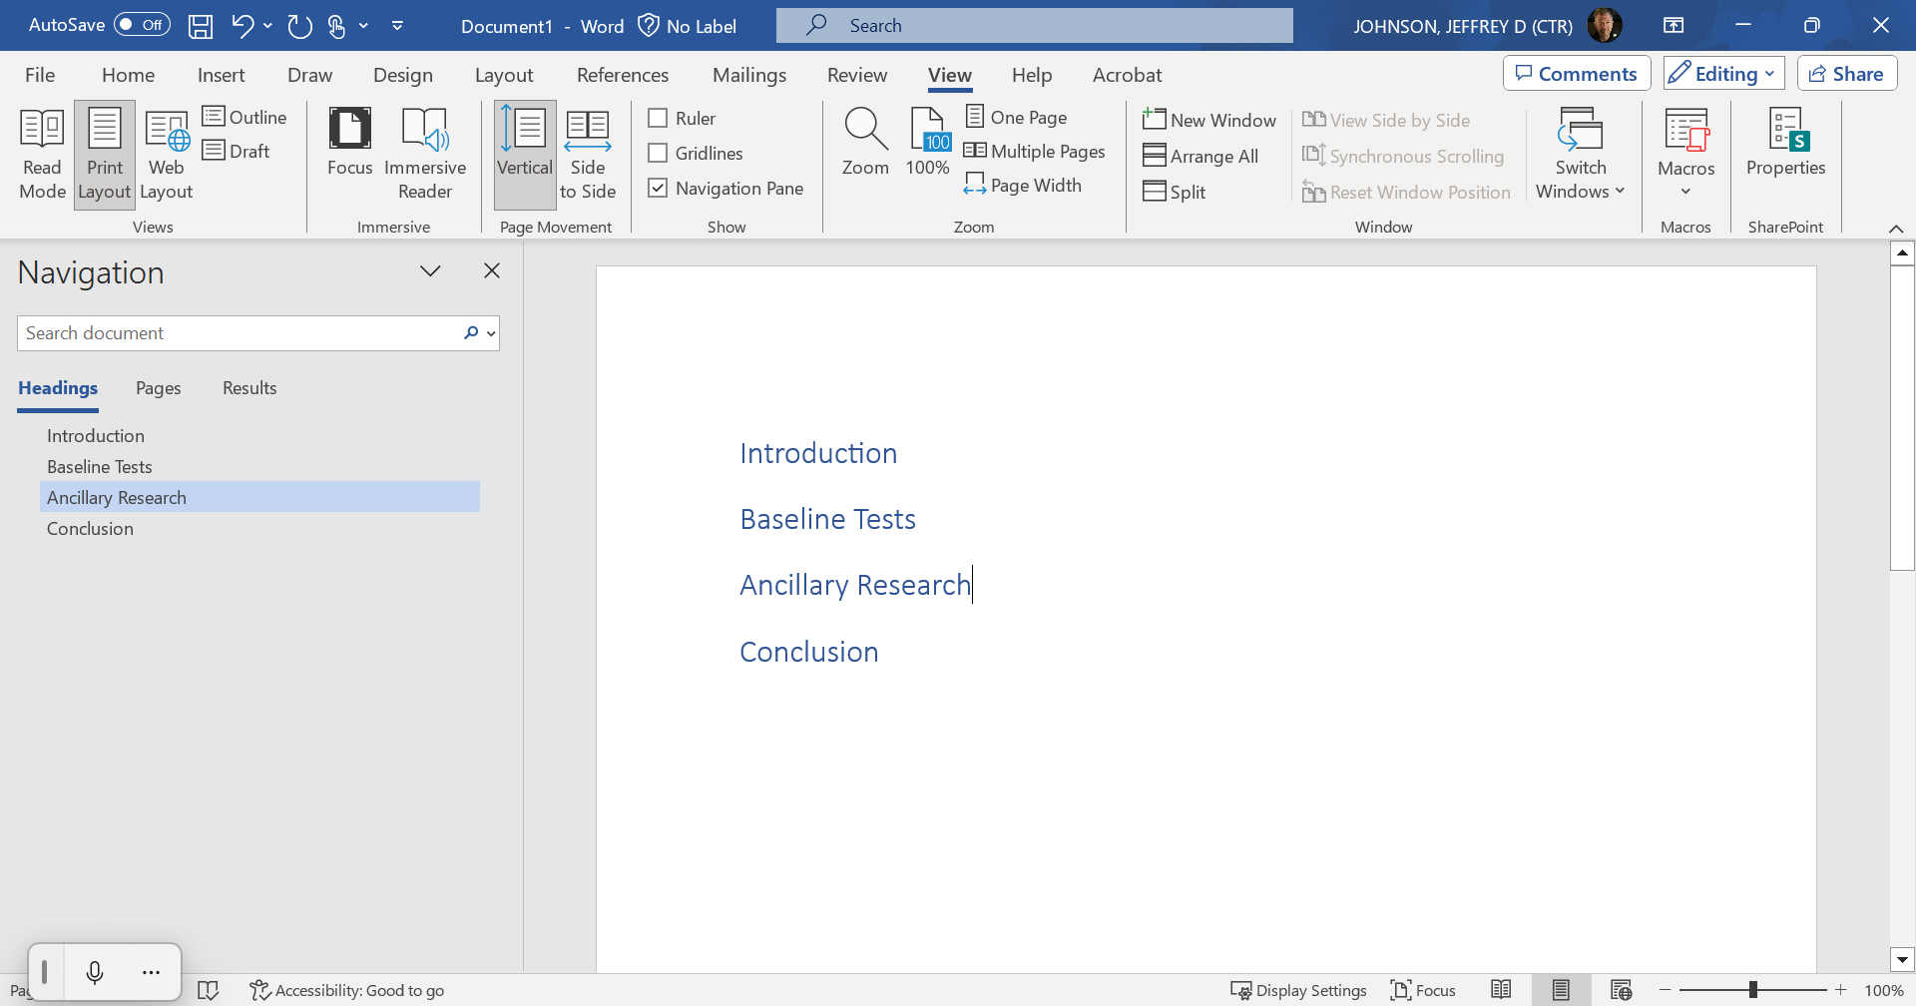

Slide 23
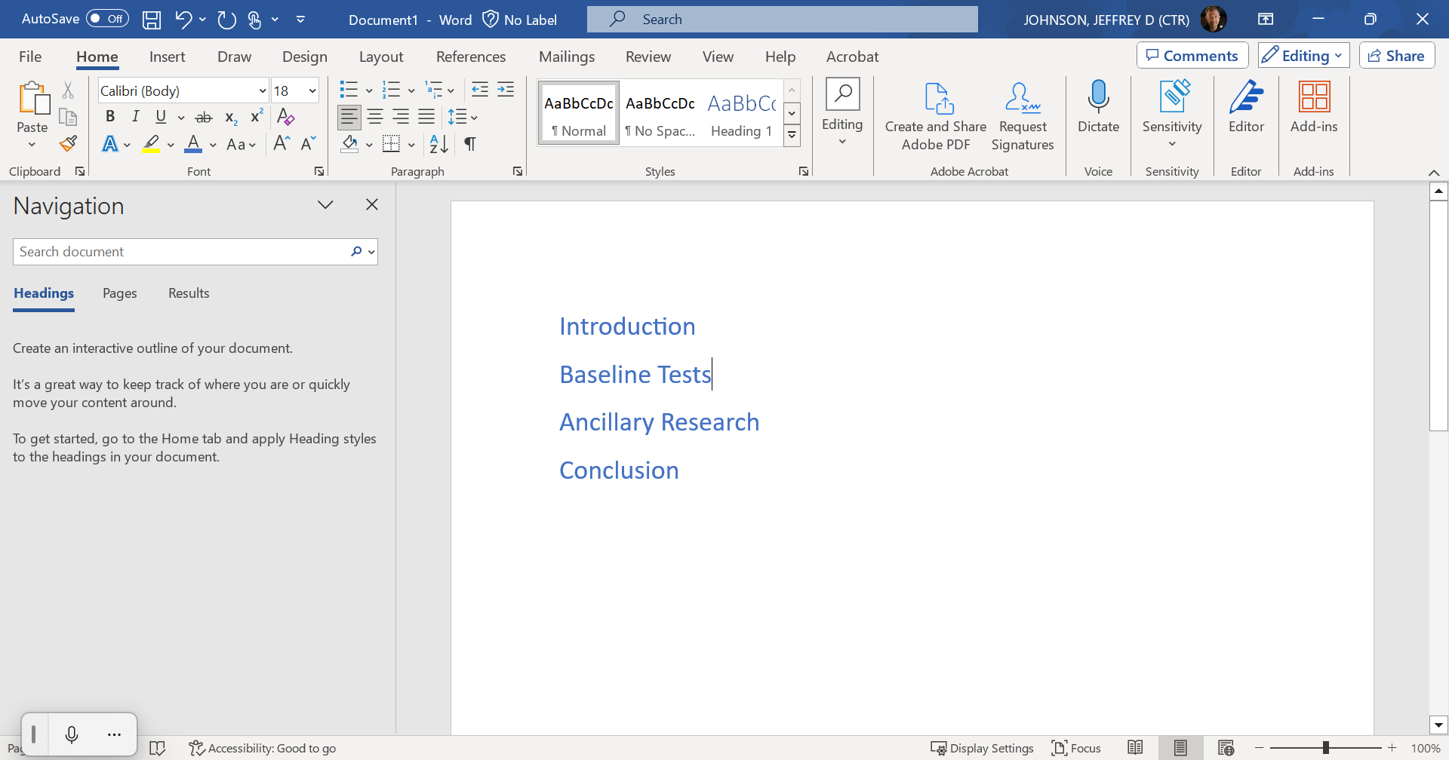

Slide 25
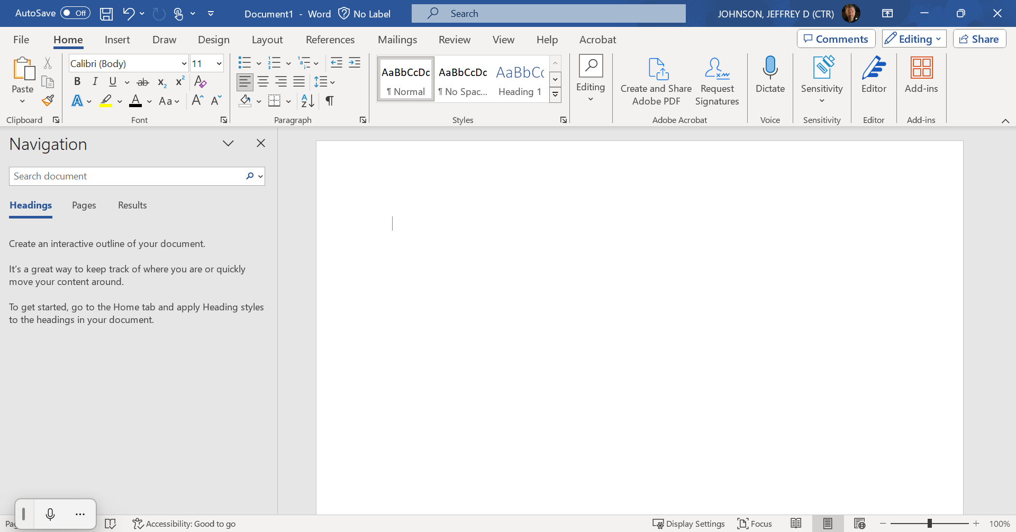

Slide 26
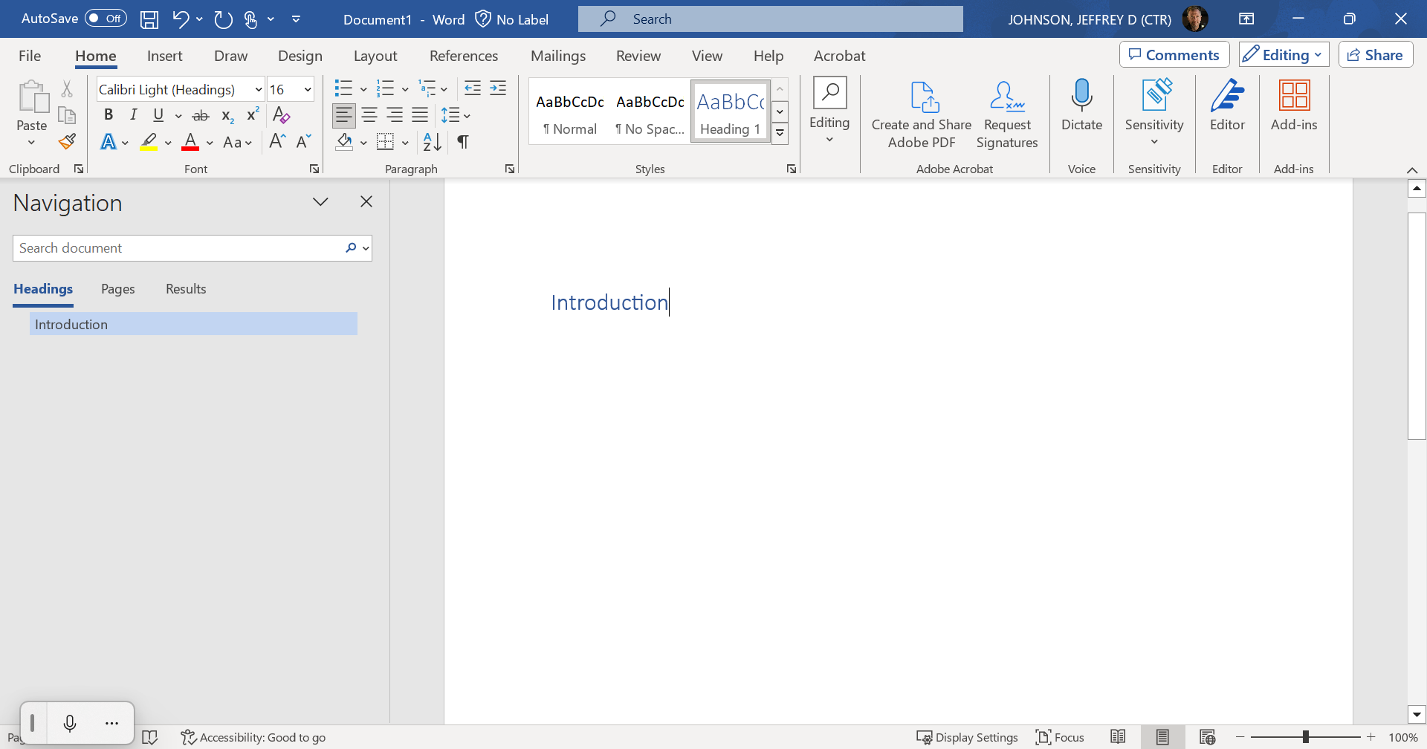

Slide 27
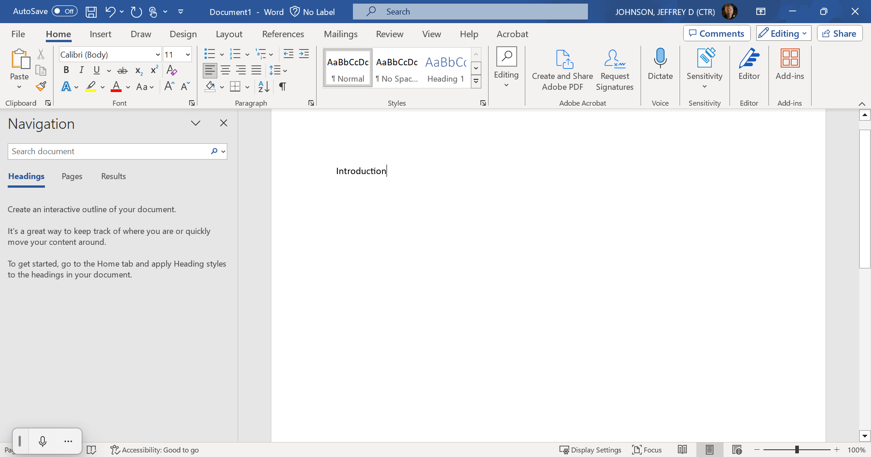

Slide 28
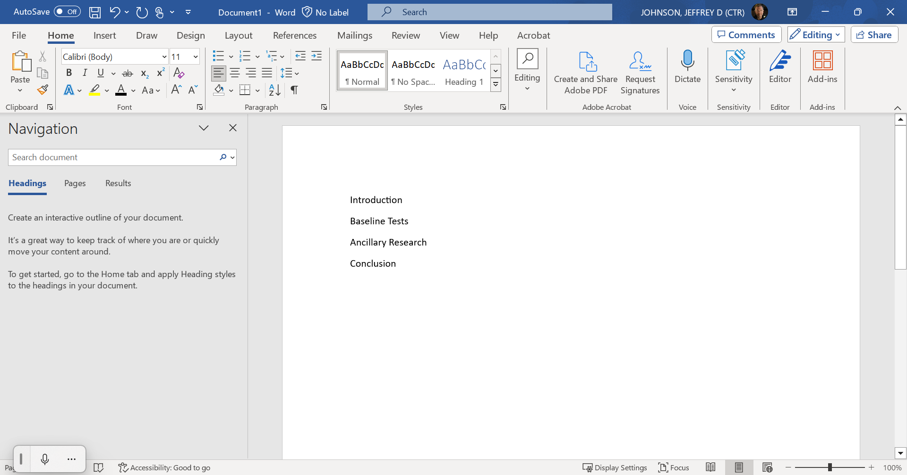

Slide 29
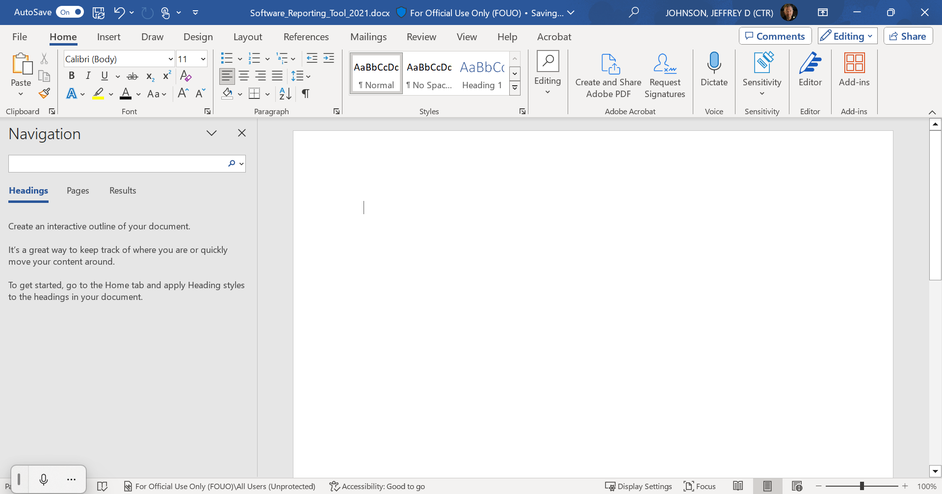

Slide 30
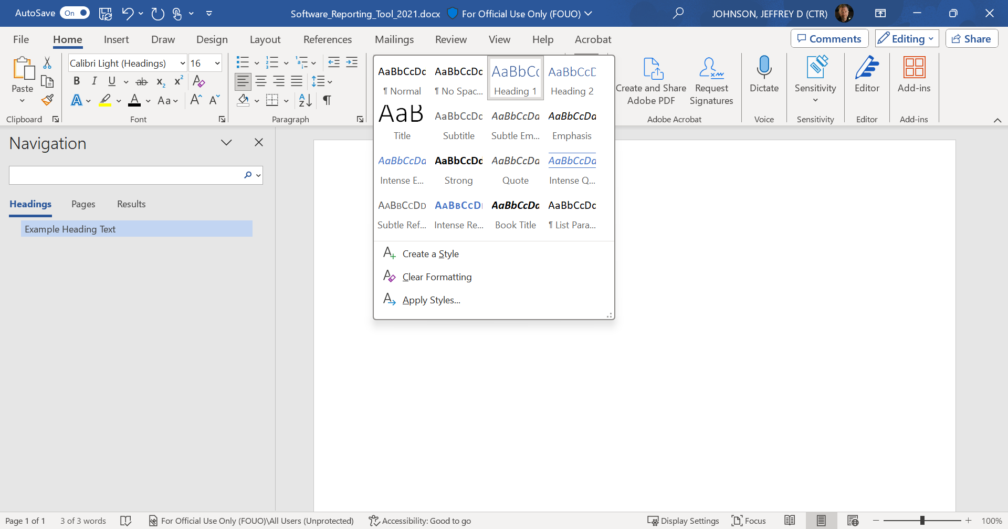

Slide 31
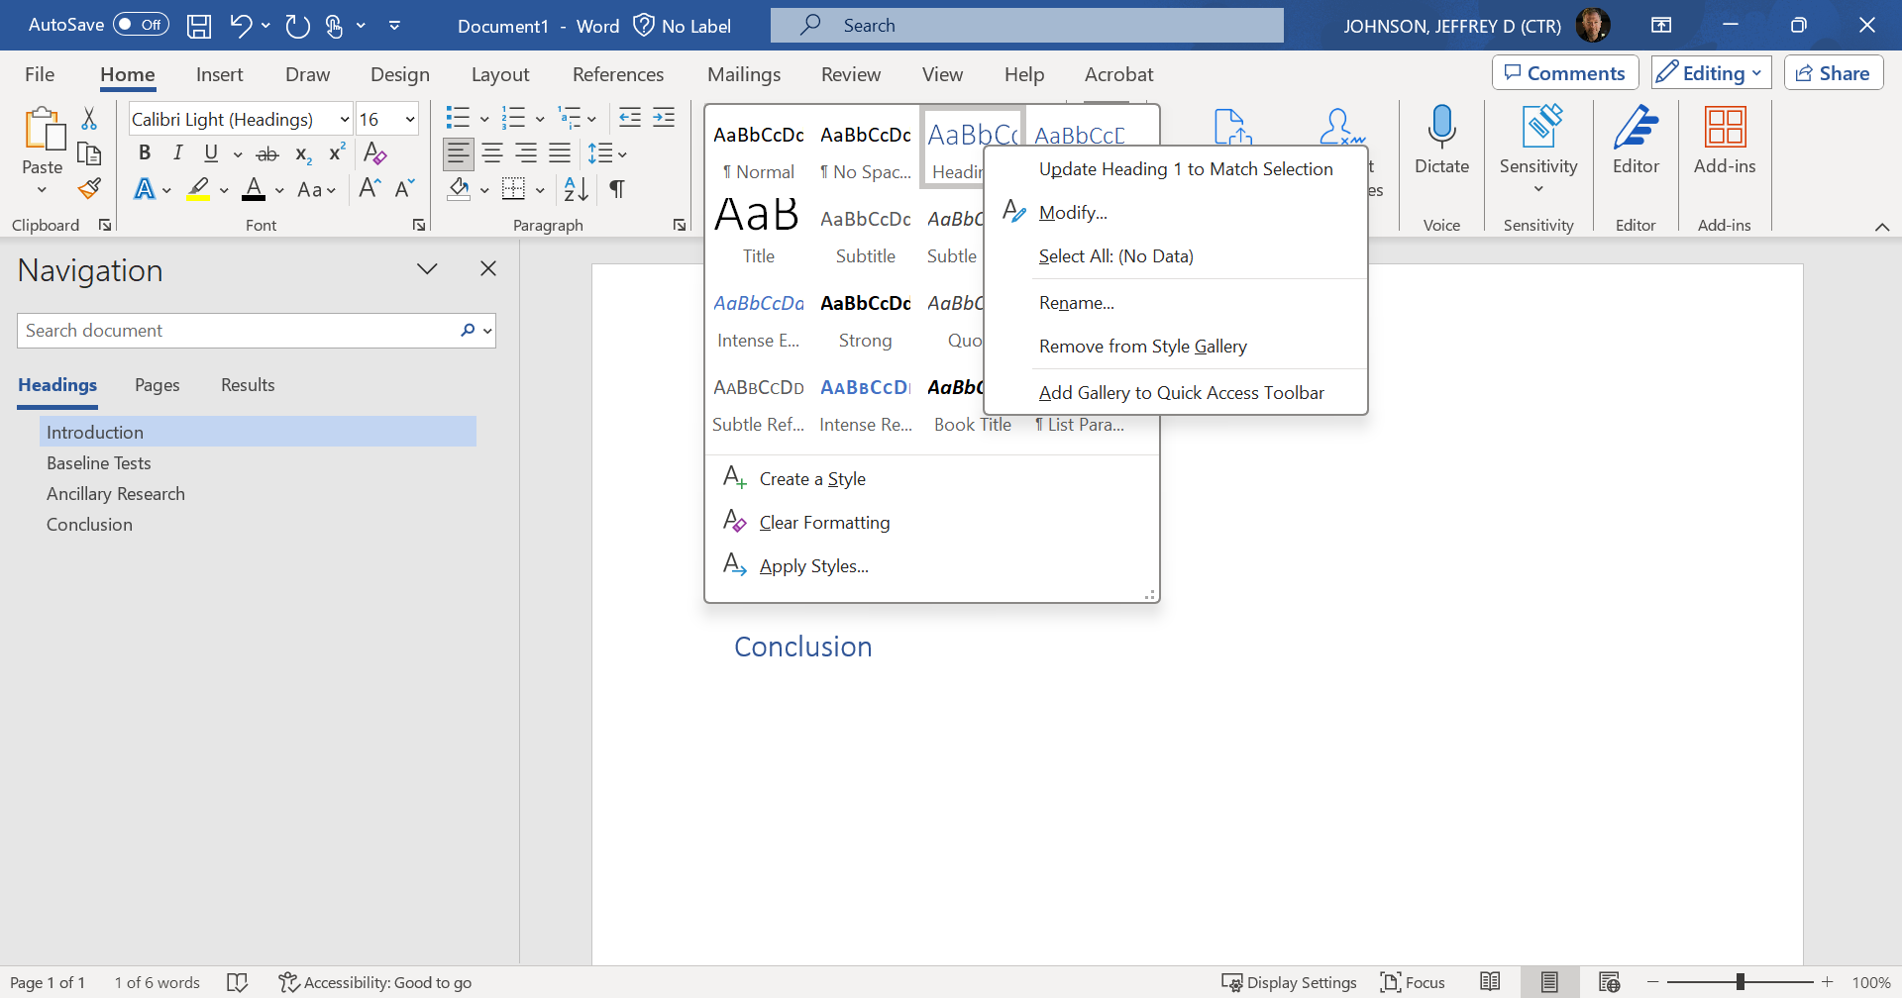

Slide 32
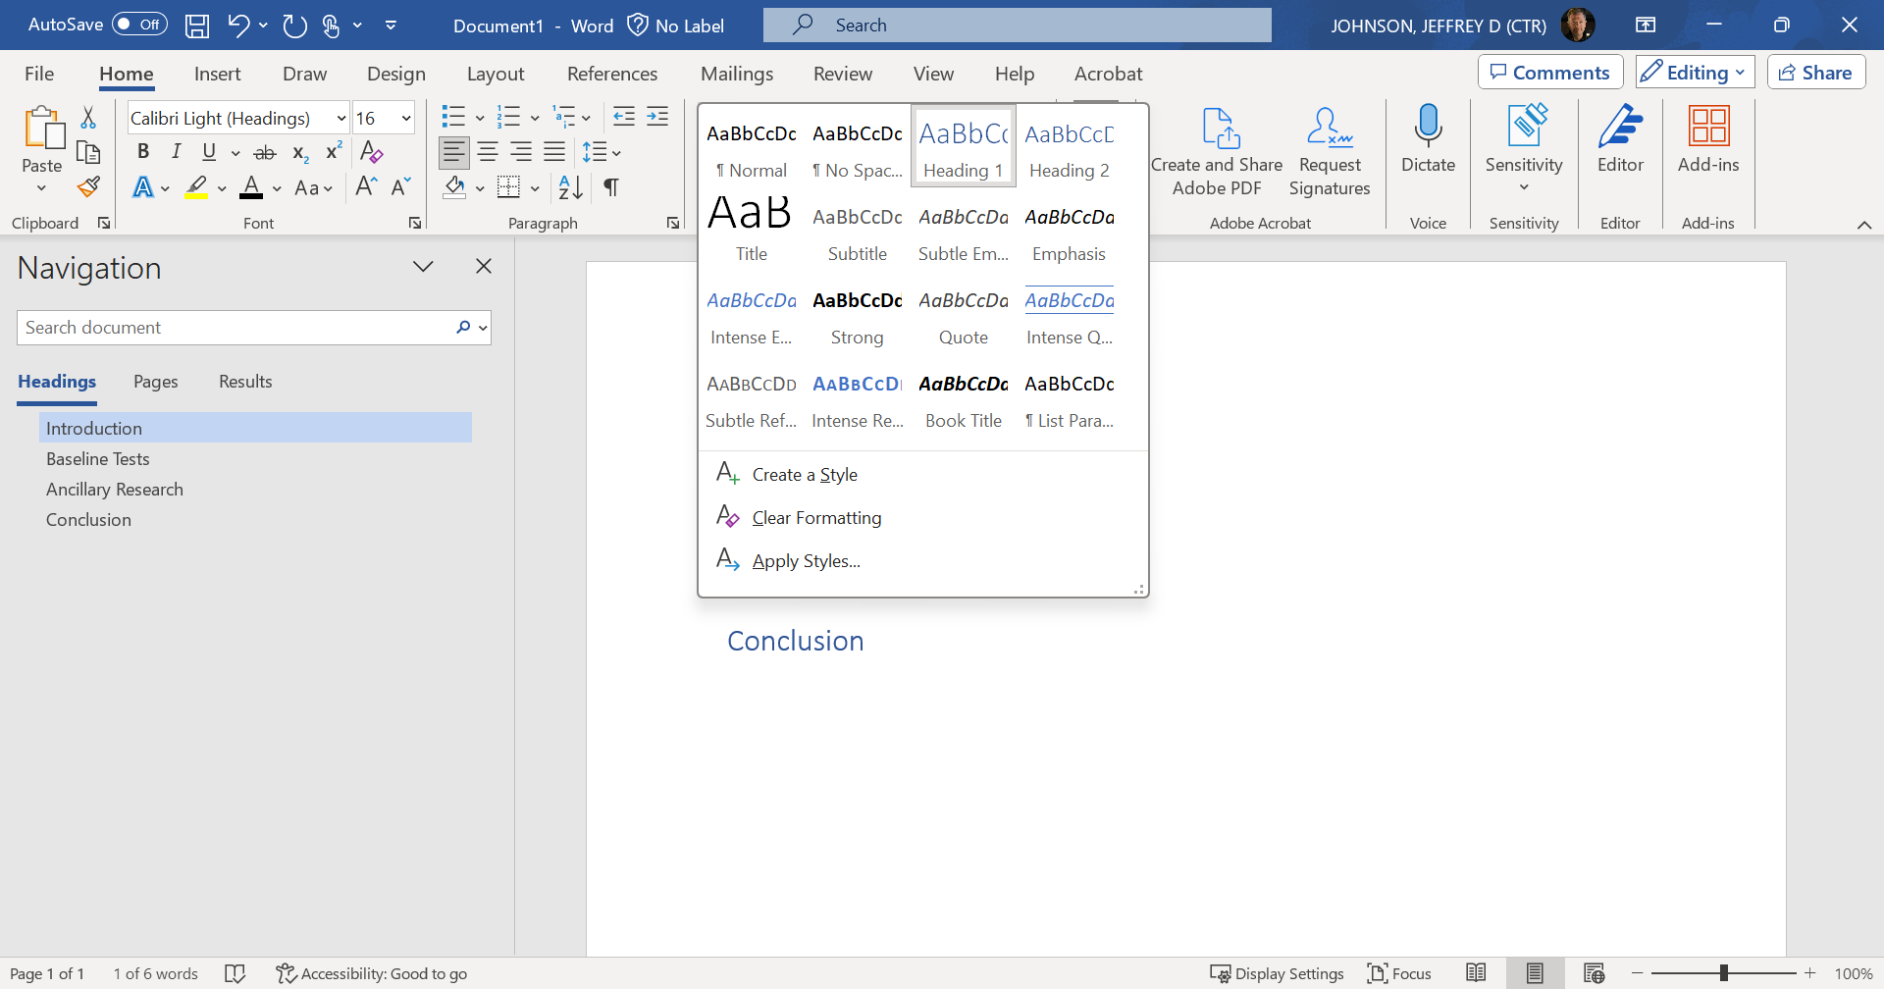

Slide 33
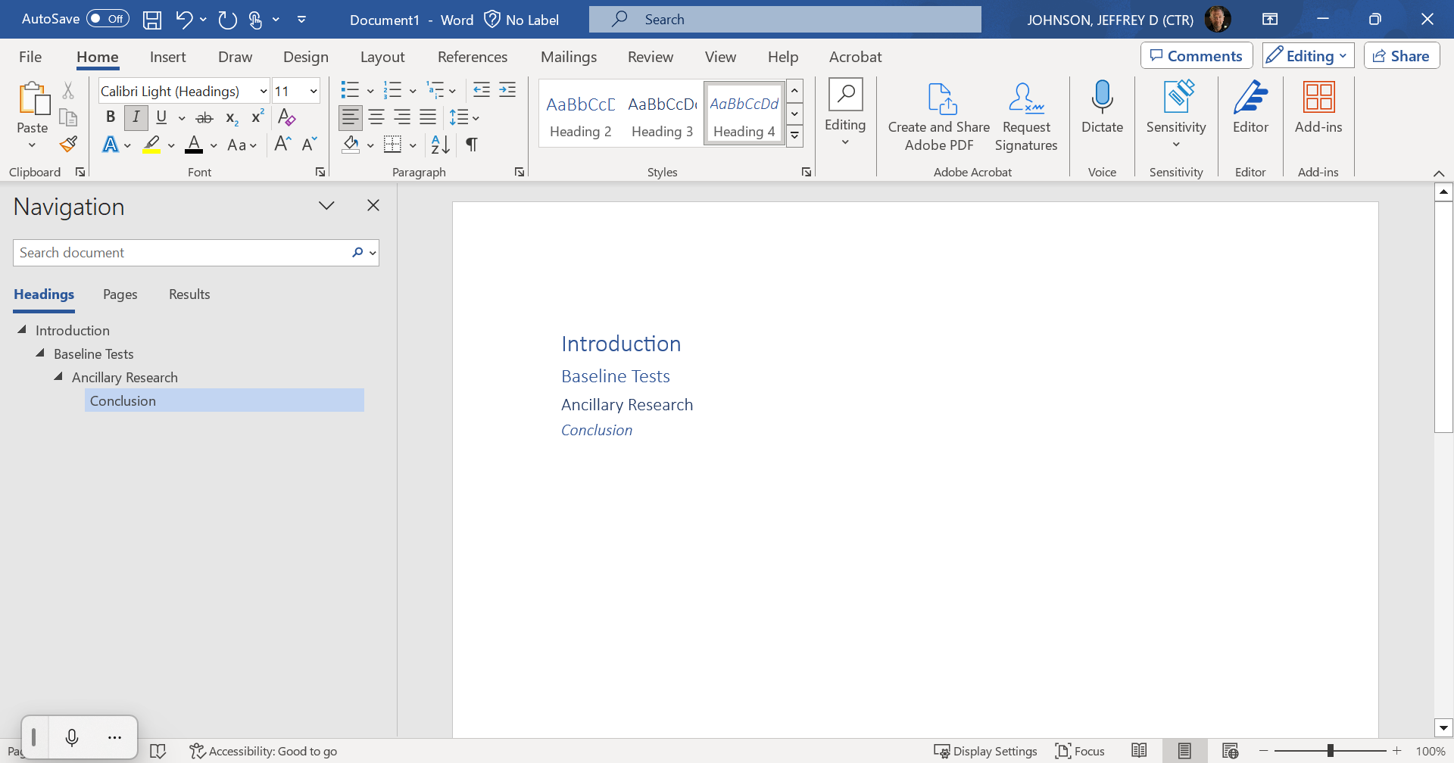

Slide 34
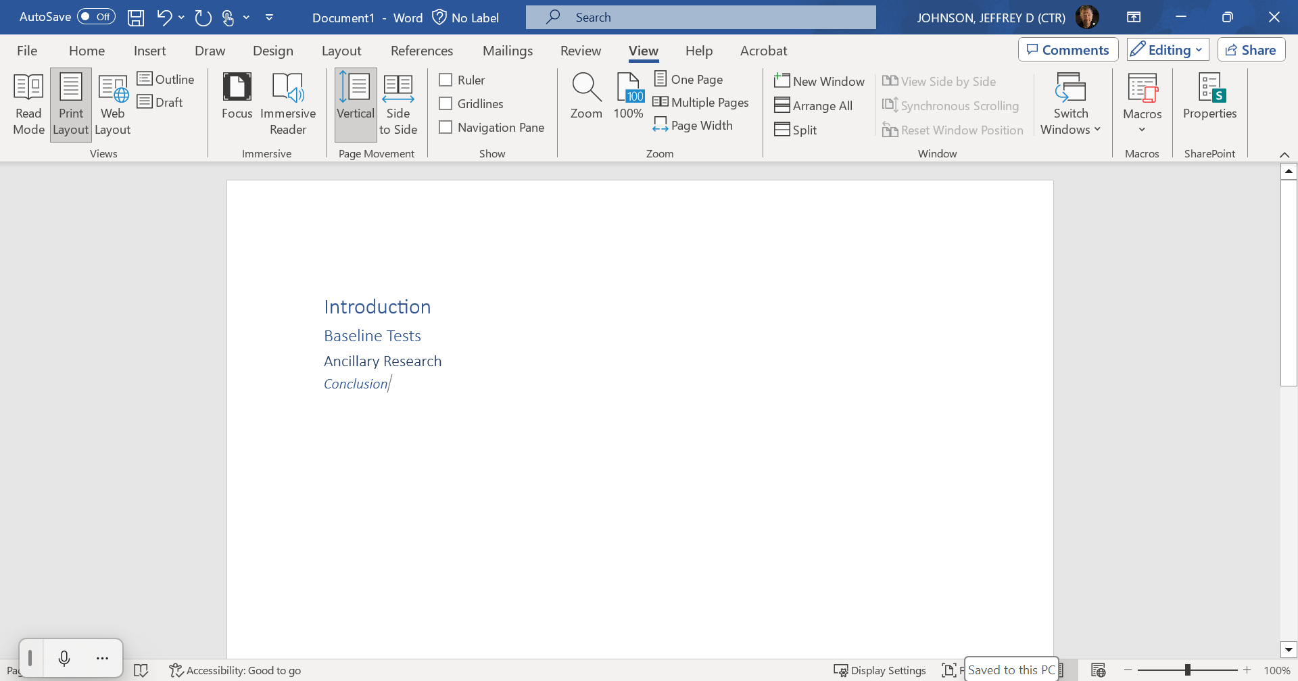

Slide 35
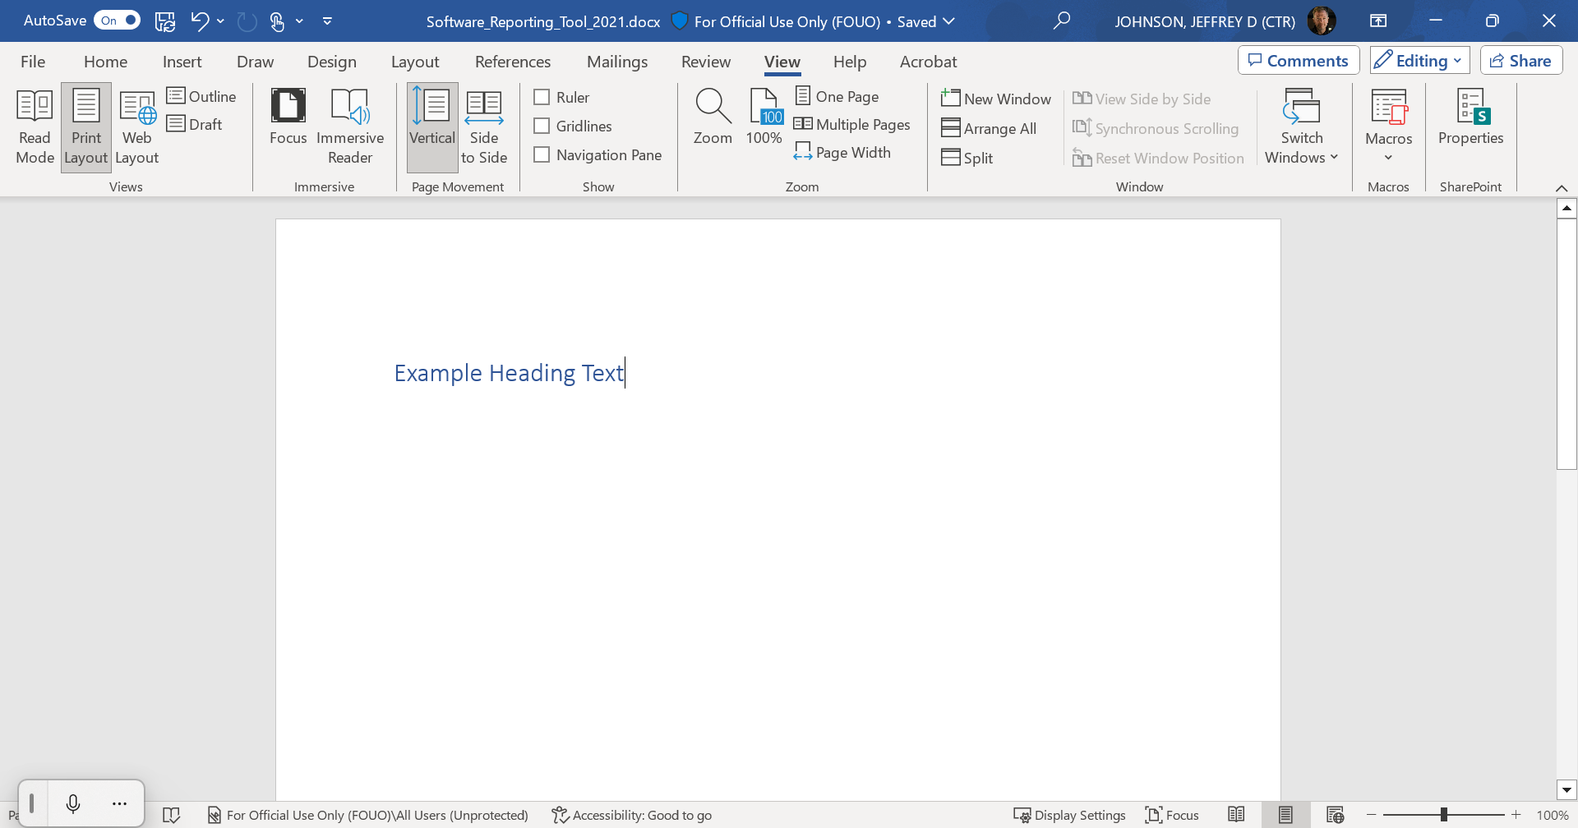

Slide 36
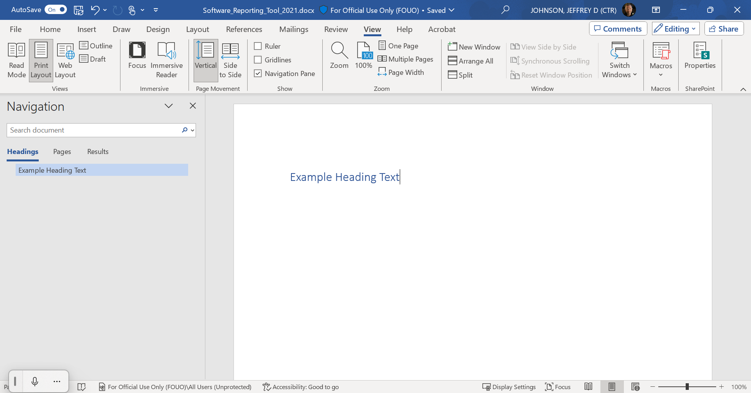

Slide 37
Thank you for watching Module 2. Please watch the entire video series to learn all the steps for authoring and testing accessible documents. For more information about creating accessible documents and other accessibility topics, visit Section508.gov.

